Slide 1
The Real Facts About
Crestview Mutual Water Co.
Proposed Well #7
Presented by Crestview Mutual Water Alliance

Slide 2
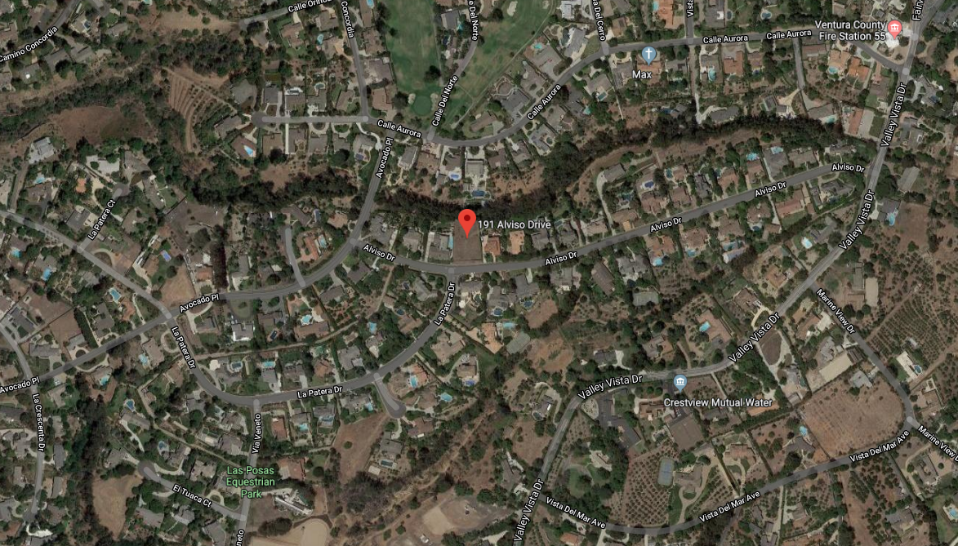
Proposed Well Location

Slide 3
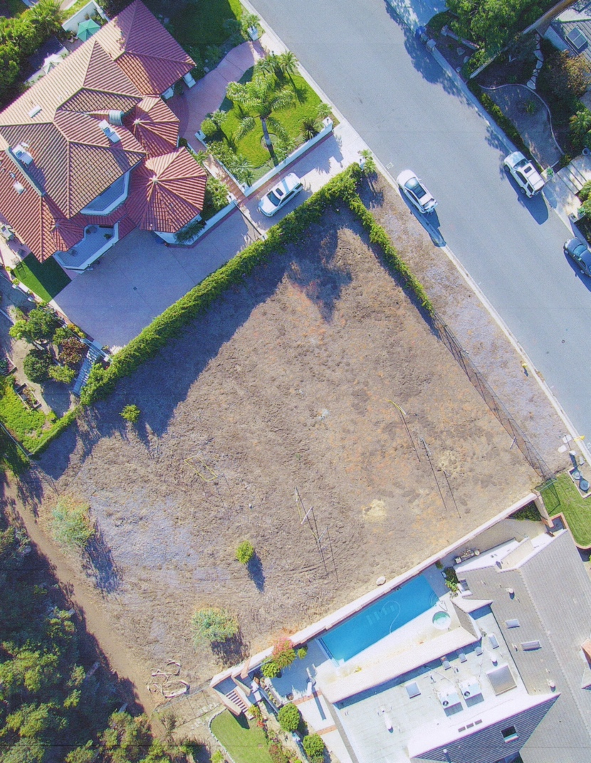
191 Alviso Dr.
Property History
Crestview purchased property in October 2015; paid $505,000
  property previous sold on 12/31/2014 for $385,000.
Homeowners Association CC&R’s do not allow for any drilling
No formal alternative site analysis conducted or produced

Slide 4
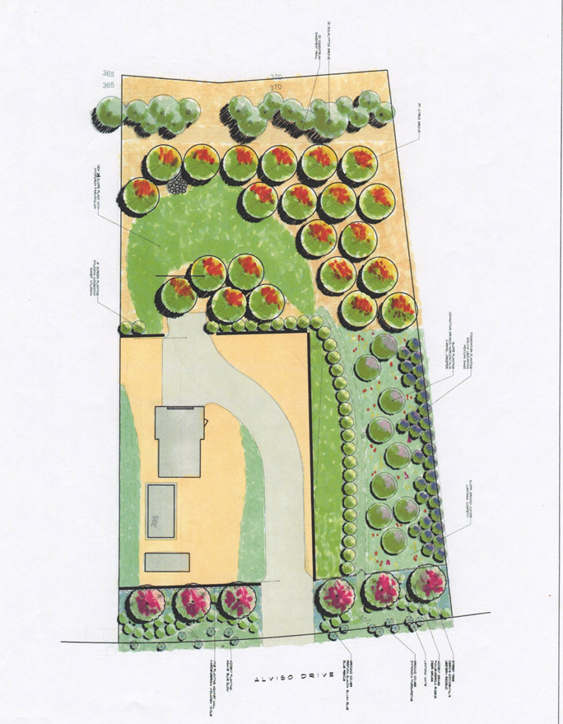
Initial Communication to Focus Group
September, 2018 - Crestview requested surrounding neighbors attend a “focus group presentation”
The presentation included draft site plan/landscape plan
Crestview offered to move surrounding neighbors to hotels for approx. 45 days due to the noise and vibration of the 24/7 drilling of the well.
Crestview offered to video/inspect surrounding properties both before and after well drilling to insure they would cover any damages caused by drilling
These offers have been rescinded

Slide 5
Drilling Concerns
State water regulations require 150 ft. setback from septic systems
County regulations require 200 ft. setback from septic systems
The proposed site does not meet State and County setback requirements for well proximity to seepage pits
Crestview’s proposed solution: 900 ft sanitary seal - this unanticipated cost will be significant.
Studies dispute safety of sanitary seal (Nebraska study – 2001-2006)
Crestview has not offered financial assistance to homeowners (after Well#7 installation) who may be required to install alternative waste treatment units at a cost of approx. $50,000 and annual maintenance of $2500/year
*Red dot indicates location of existing septic system. The larger circle surrounding each represent the appropriate setback of 150 ft.

Slide 6
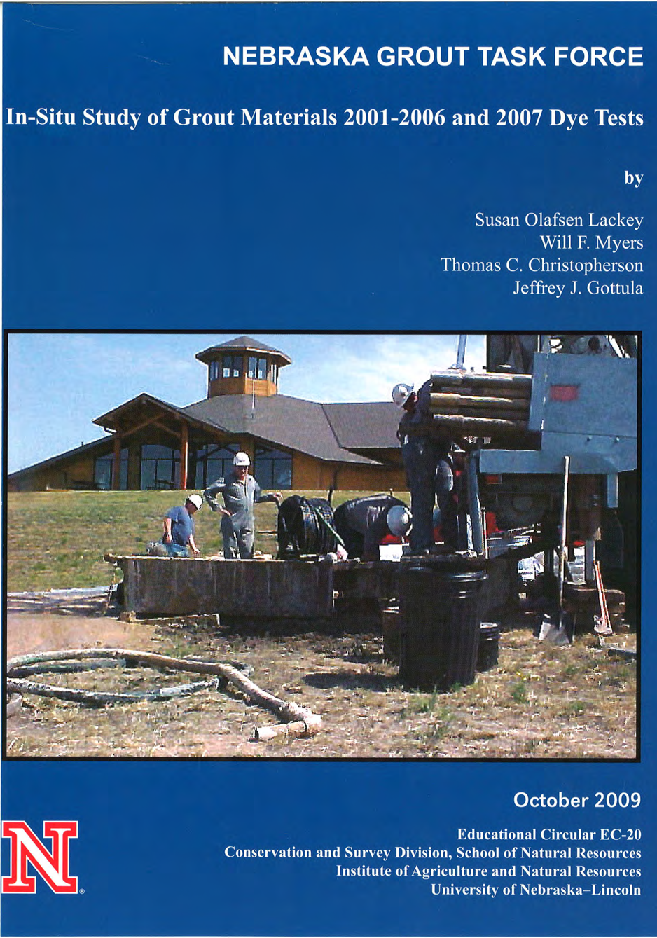
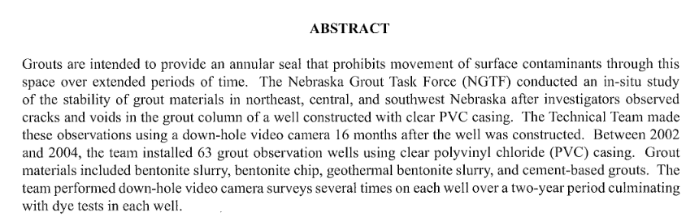
Sanitary Seal
In October of 1999 a well was constructed with a transparent casing to use in an educational program.
The transparent casing and screen were clear enough to allow a down hole camera to examine the placement of the sand filler pack and bentonite sealing materials.
An inspection performed 16 months after construction revealed cracks and voids that could allow surface contaminants to move though the grout and into the groundwater
This study has been recognized by the State Water Resouces Control Board.

Slide 7
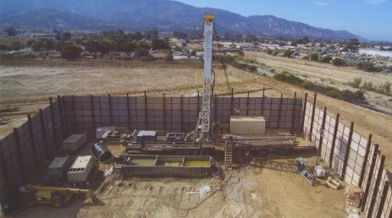
Noise and Property Impacts
Well drilling proposed for 24/7 for 30-45 days.
Well drilling requires ample space for the drilling equipment and proper sound mitigation tools.
There are limited alternatives to provide sufficient noise control.
There is a high probability that this practice will cause lasting damage to neighboring properties.
Crestview has not indemnified adjacent properties for any potential damages.
This photo was taken of a well drilling operations in Santa Paula.
This well had a proposed depth of 840ft – Well #7 has a proposed depth of 1400 ft
The contractor erected sound protection walls at a height of 25 feet secured to I-beams that had been driven into the earth to a sufficient depth to prevent any movement under anticipated environmental loading.
Nearest dwellings approx. 330 Ft

Slide 8
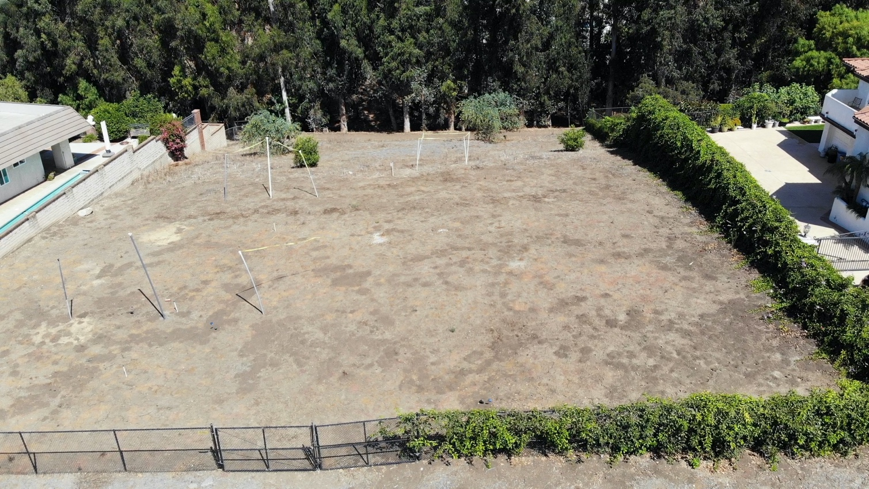
Grading and Retaining Walls
CUP application appears to underestimate the required grading on the hillside lot.
Adjacent properties all have retaining walls due to slope.
The proposed site does not have any existing infrastructure.
The lot size and location make it less than optimal for drilling equipment.
*Red line indicates severity of existing slope

Slide 9
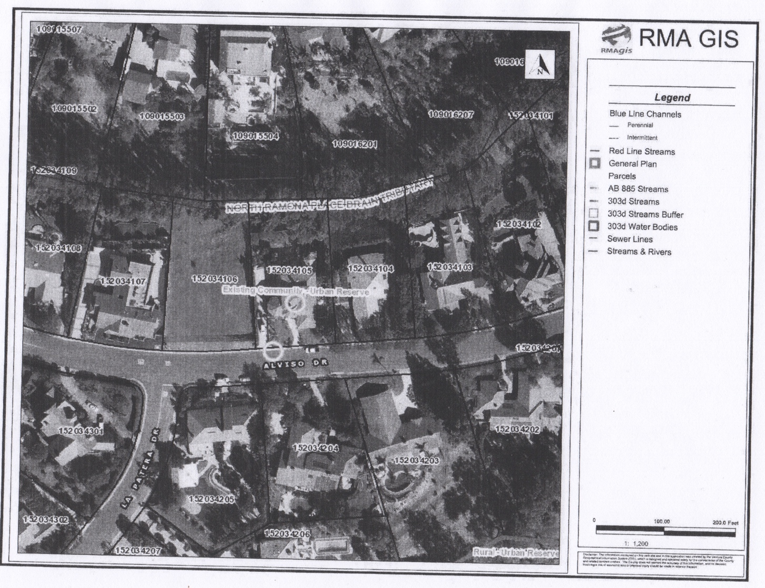
Environmental Impact
Proposed well expected to discharge drilling water into a blueline creek at north end of property
Crestview has not acknowledged that flow easements on property are owned by Homeowners Association
Blueline creek runs over private property – no communication on potential impact
Project documents that have been submitted to the county describe the blueline creek as “an existing drainage SWALE”

Slide 10
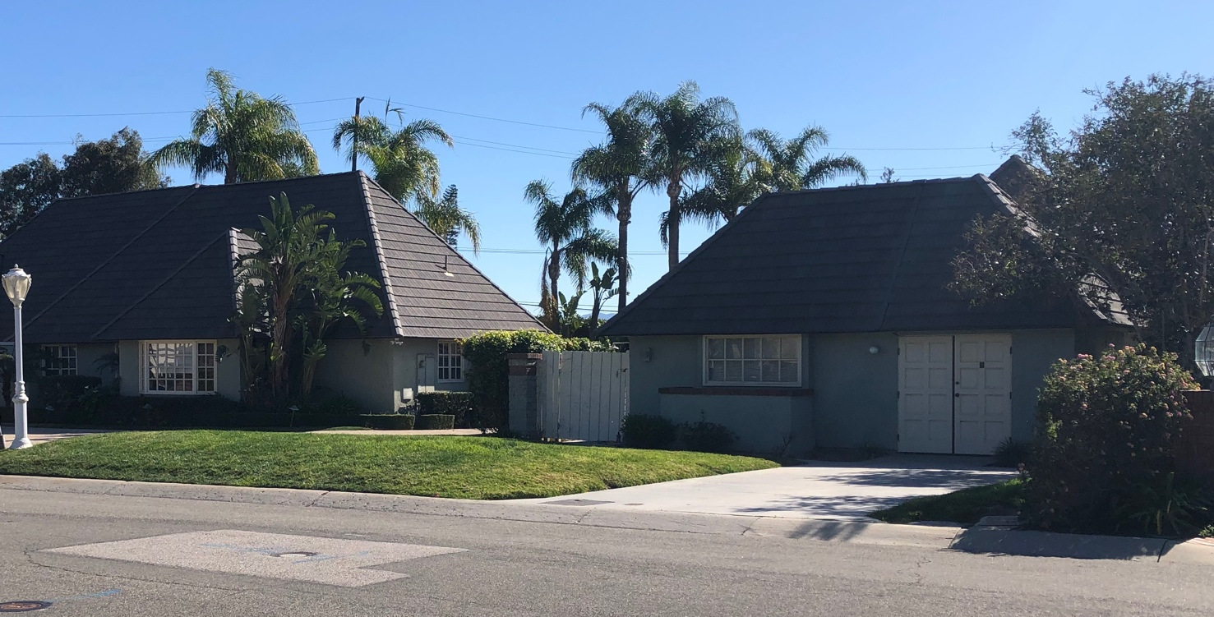
Existing Well #4
Well site #4 was originally deeded by the developer of the Las Posas Hills in 1978 for the purposes of a well before the HOA was formed in 1982.
At the time of construction the well enclosure was incorporated into the architectural design of the home.
The Developer minimized the impact to the development to maximize the property values of their project.
This well site would not be permitted today and the methods of well construction would not meet the current regulatory standards of the State and County.

Slide 11
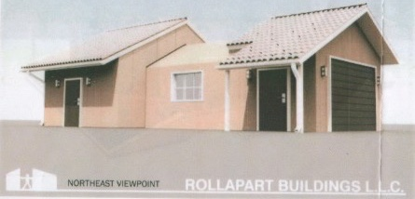
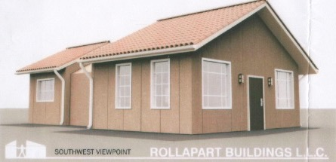
Proposed Well Enclosure Is An Industrial Steel Building
Crestview intents to build a 1,400 ft. industrial metal building. There is no comparison to Well #4, which integrates nicely with the rest of the neighborhood.
The HOA CC&R’s DO NOT permit steel buildings or roofs. CC&Rs also require a minimum structure of 2,500 sq.ft.
The CC&R’s prohibit this type of construction to ensure that all homes in the area meet a minimum standard of development. The proposed structure would have an adverse effect on property values of existing homes.

Slide 12
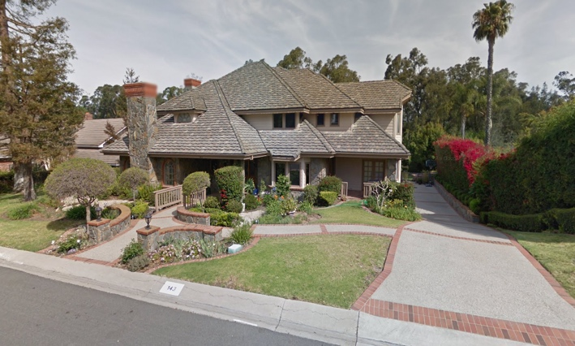
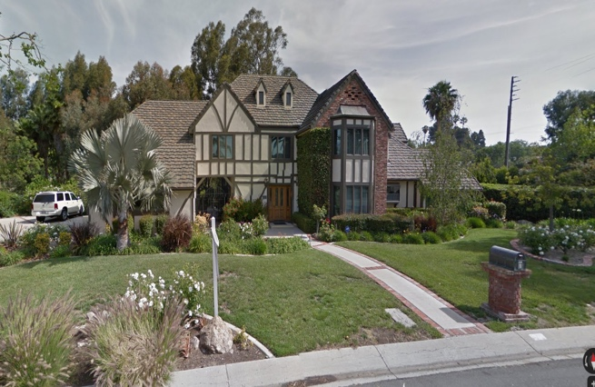
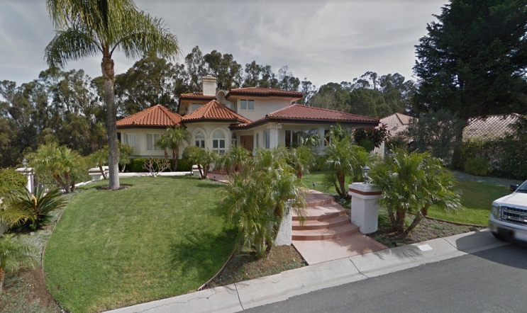
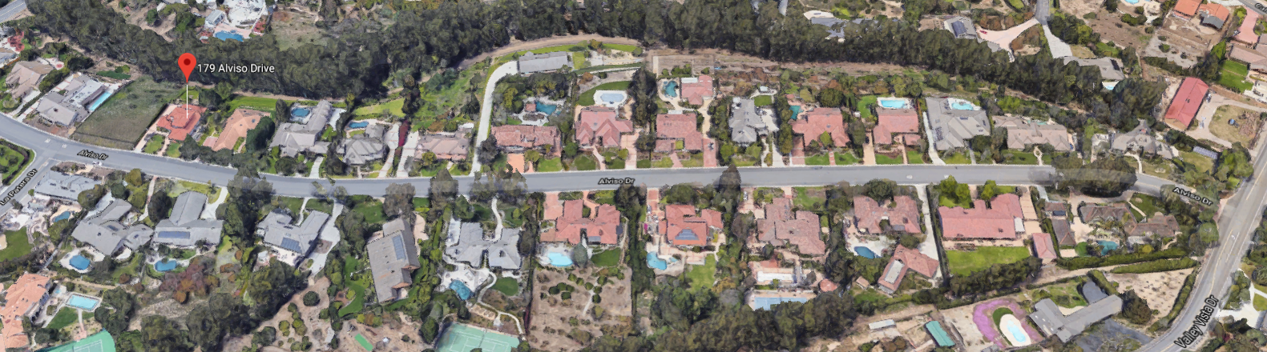
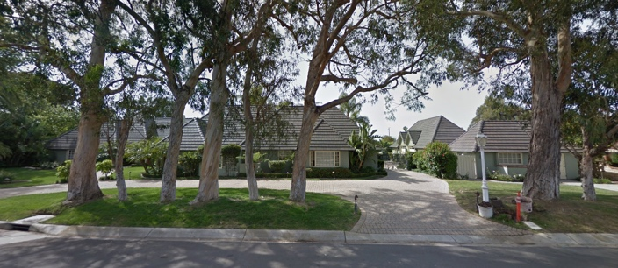
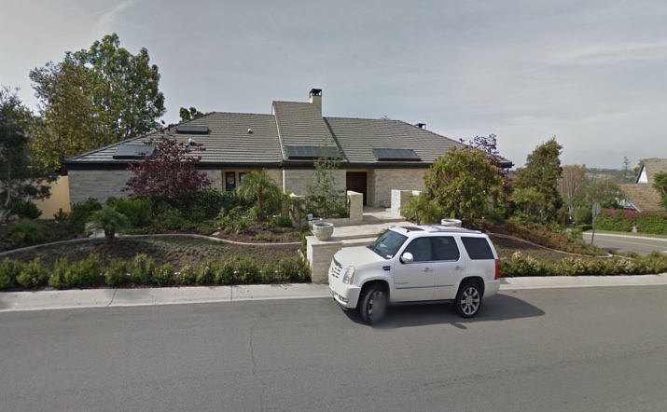
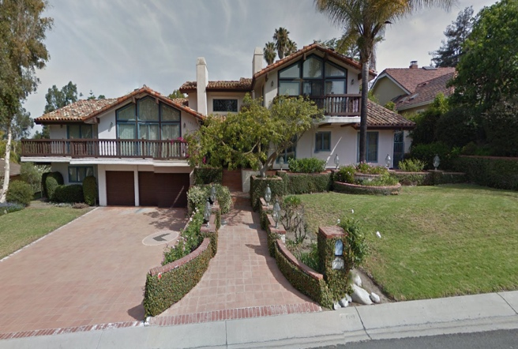
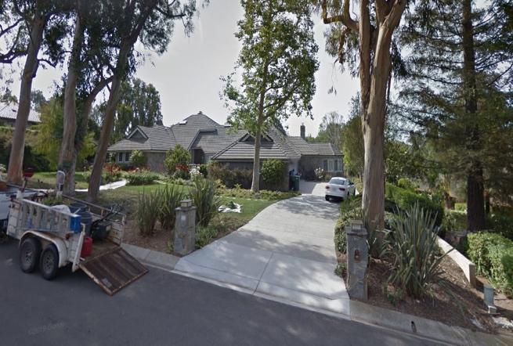
HOA Compliant Homes

Slide 13
Summary
HOA has rejected the wellsite plan proposed by Crestview
Homeowners Association CC&R’s do not allow for any drilling
The proposed plan submitted by Crestview does not meet the architectural standards set out by the HOA / CC&R’s. As of current date Crestview has broken all communication with HOA and residents.
Crestview has made no attempt to resolve the concerns presented by the HOA and neighborhood residents. Attempts by shareholders to discuss Well #7 has been moved to Executive Session, thereby ceasing further discussion.
Crestview will not indemnify homeowners that will be impacted by the project.
The size of the site and location on hillside prohibit traditional drilling means and methods.
THERE HAS BEEN NO LAWSUIT FILED BY RESIDENTS OR HOA
CRESTVIEW’S FOCUS IS ON GETTING APPROVAL FROM COUNTY, REGARDLESS OF FINANCIAL IMPACT TO SHAREHOLDERS AND SURROUNDING AREA.

